Slide 1


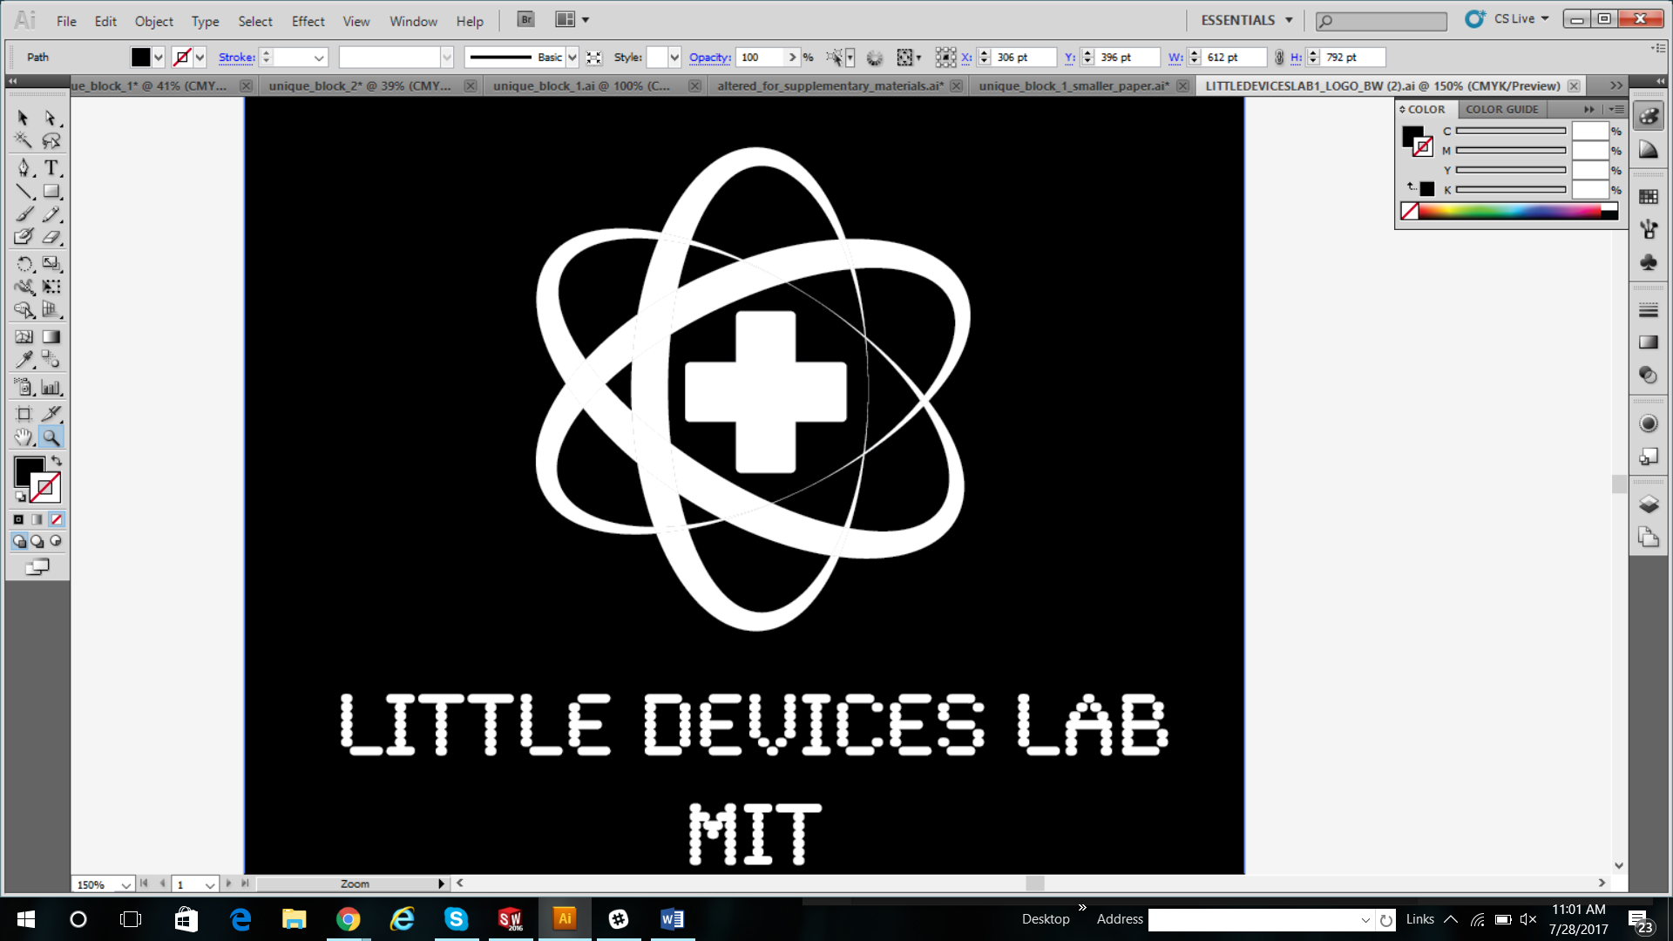
BIOREACTOR
August 2017

Slide 2
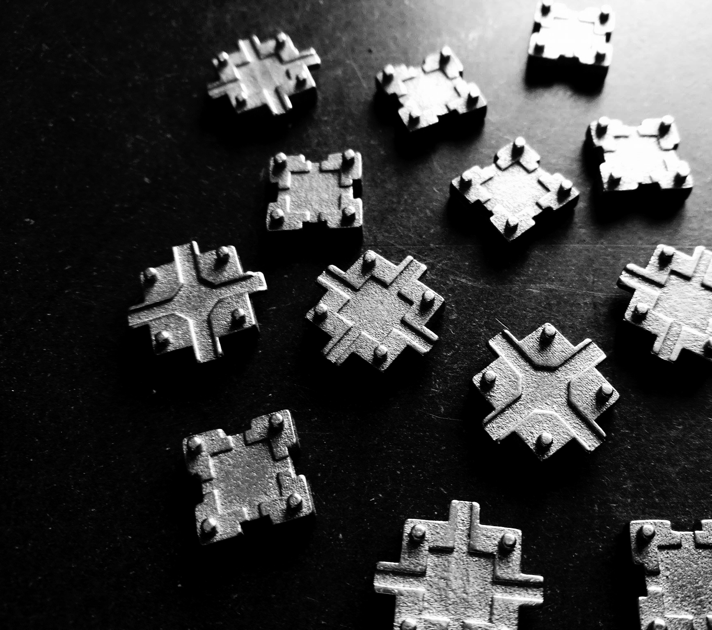
This Week
60 bioreactors full of yeast grown
200 students
27 teachers
3 MIT Student Teachers
4 days
18 hours in class

Slide 3
General Common Background

Slide 4
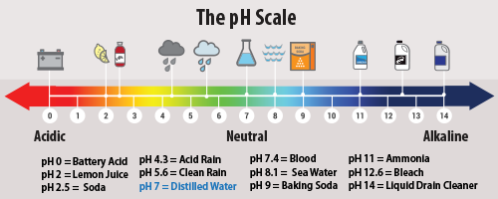
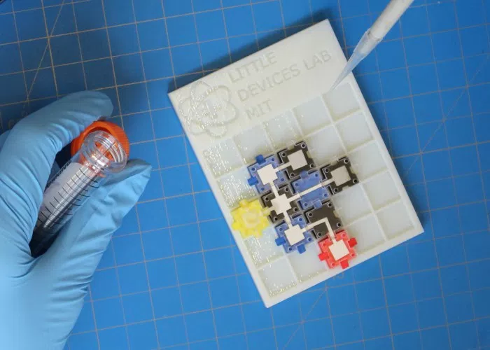
Chemical Circuit Design - using food coloring, pH detection, and a mild acid
Notes:
Flow and pH experiments

Slide 5
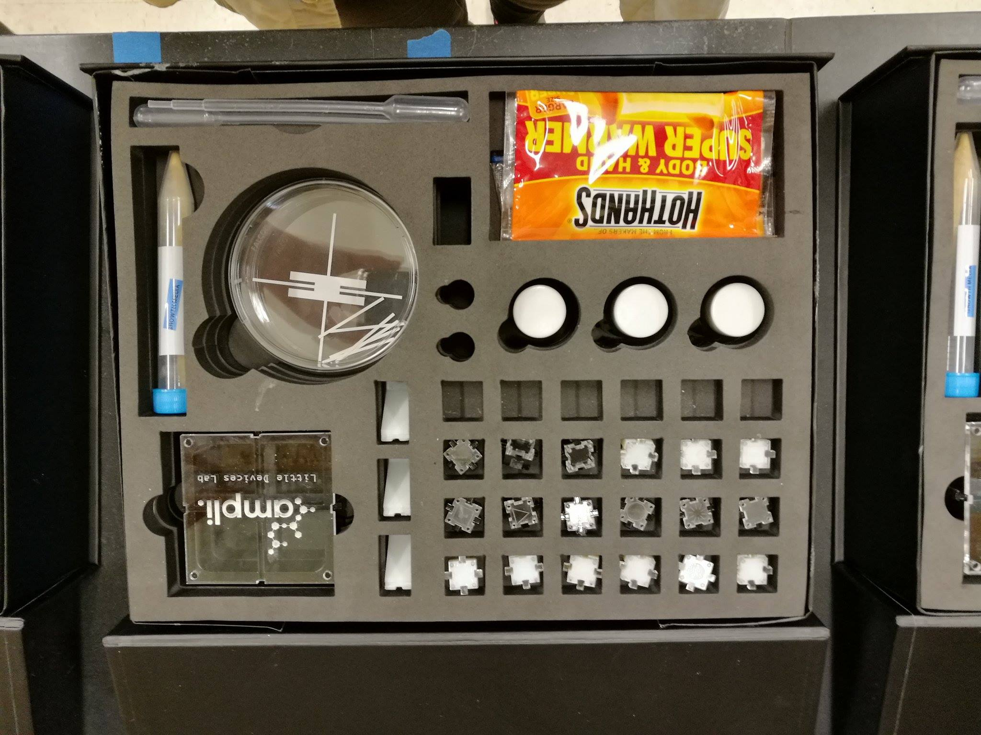
Ampli Chemical Circuit
Ampli Biochemistry Kit

Slide 6
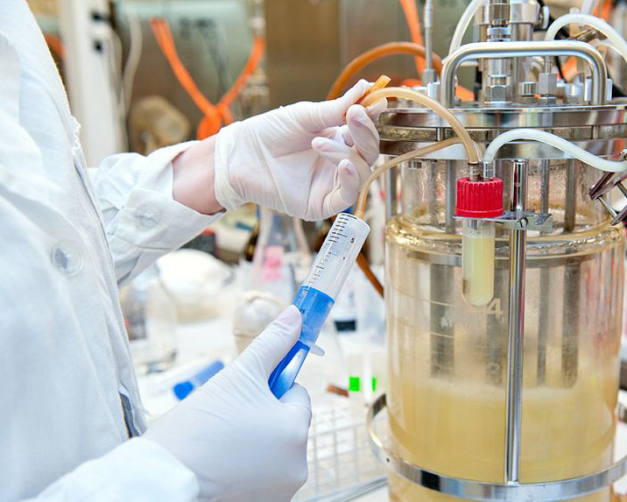
noun
an apparatus in which a biological reaction or process is carried out, especially on an industrial scale.
Fermentation chambers are bioreactors where organisms (yeast) grow and produce useful produce chemicals or products.
What is a Bioreactor?
Notes:
https://www.google.com/search?q=bioreactor&source=lnms&tbm=isch&sa=X&ved=0ahUKEwjh1J3bybLVAhWI7YMKHSzYB-wQ_AUICigB&biw=787&bih=716#imgrc=2zFrFDQcCliPYM:

Slide 7
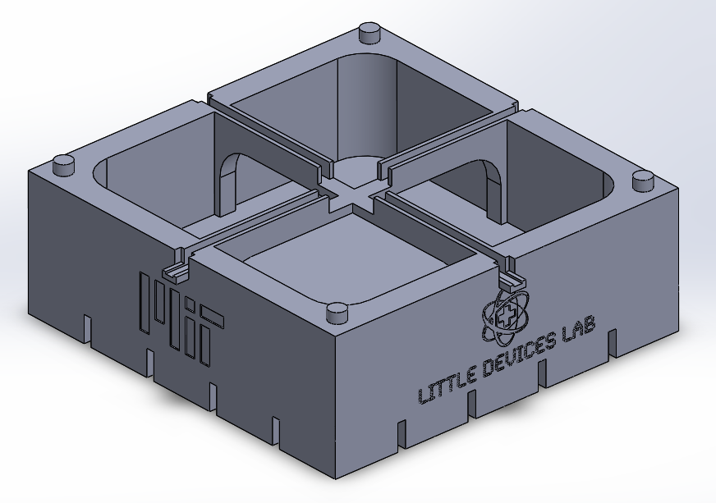
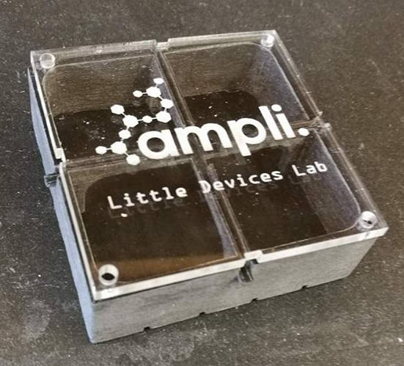
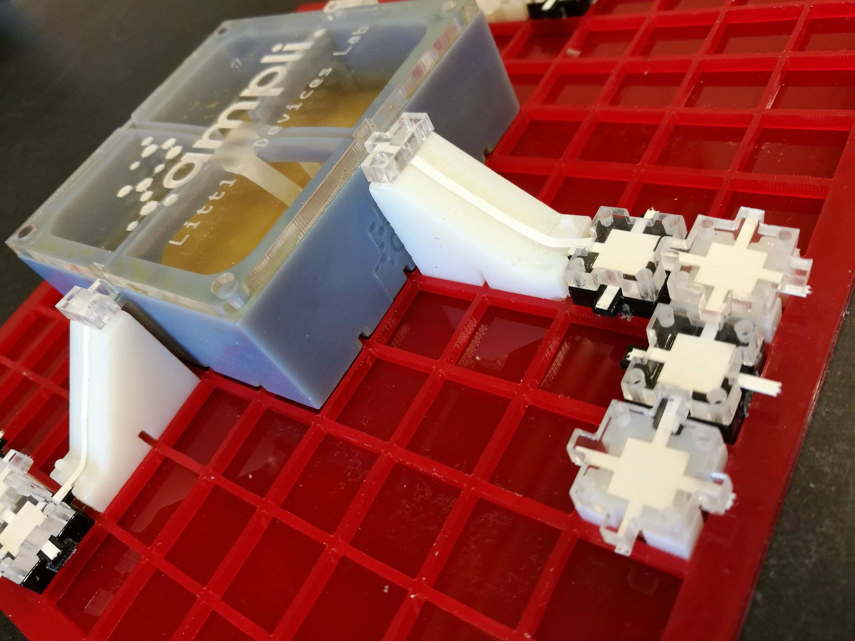
The Ampli Bioreactor
Notes:
Kept weird photo for presentation

Slide 8
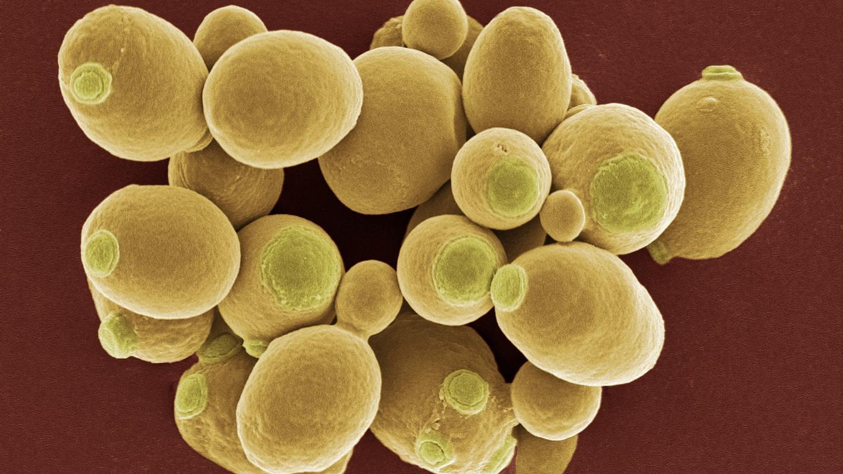
Yeast are single-celled microorganisms that you can find in both labs and kitchens
Yeast require certain things to live and grow:
Nutrients and sugar (in growth medium, or fruit/vegetable/grain mash)
Warm environment
Life-safe pH (range around pH 7)
Notes:
About yeast and growth

Slide 9
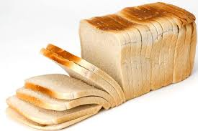
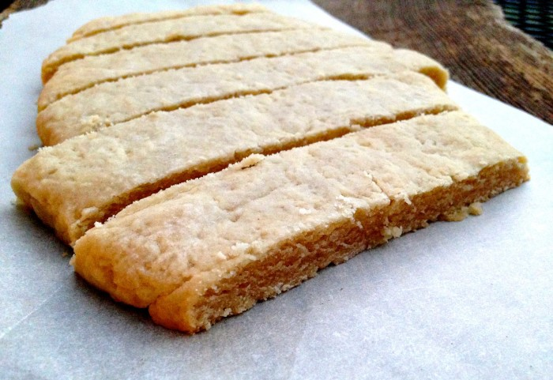
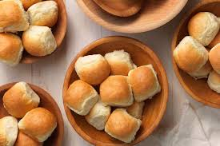
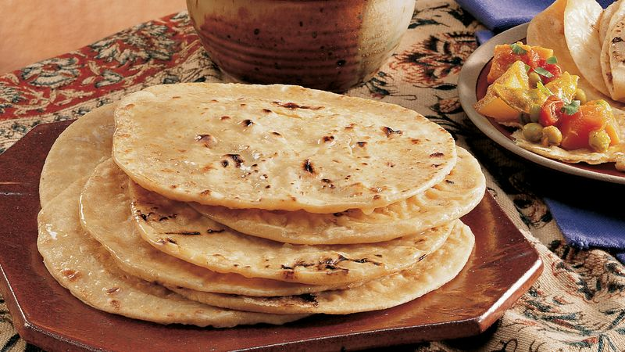
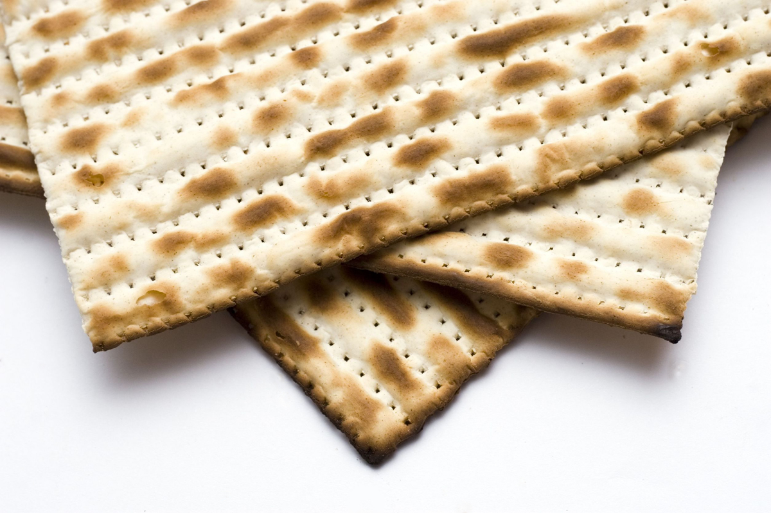
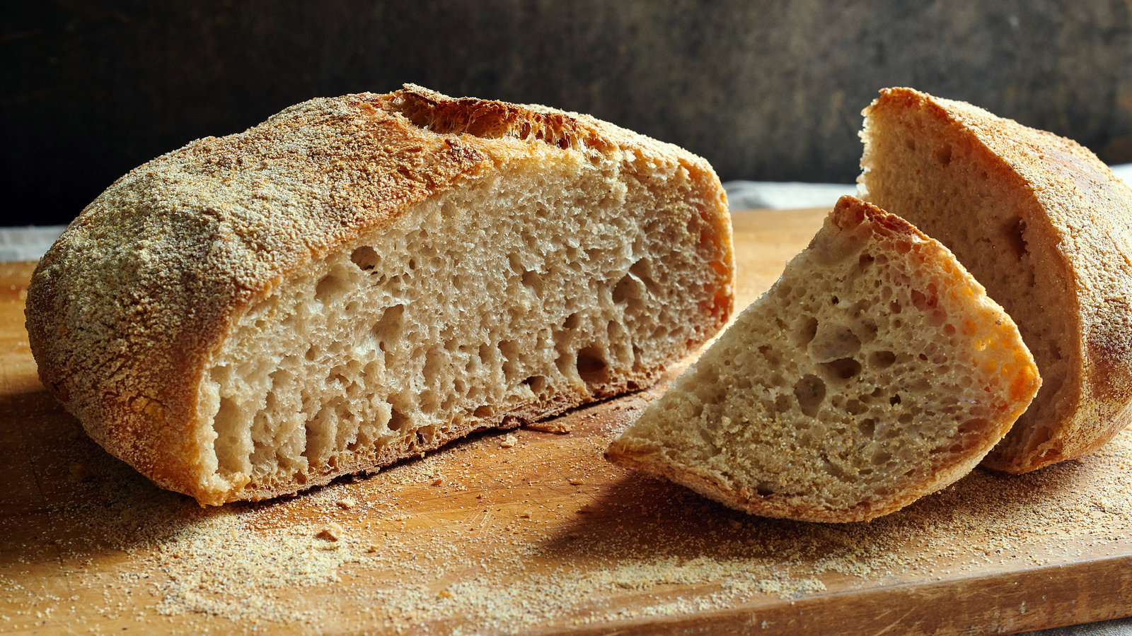
Leavened
Unleavened
Yeast and Bread
Yeast eats sugar and releases carbon dioxide and alcohol.
Yeast contains enzymes that help to break down bread ingredients into simple sugars that the yeast can eat. The air bubbles found in leavened bread are from alcohol and CO2 that is produced when yeast eats these simple sugars.
Notes:
http://www.finecooking.com/article/yeasts-crucial-roles-in-breadbaking

Slide 10
Fermentation happens when...
Yeast have sufficient sugar to consume
Low-oxygen environment
Good yeast life conditions without harsh substances
How do you think each of these factors would affect fermentation? Would you like to test any?
Type of sugar or fruit in the bioreactor
Plastic wrap or regular lid?
pH? Temperature of the bioreactor? Amount of ethanol in the bioreactor?
How do you think fermentation affects pressure in the bioreactor? How about temperature? Think about what you know about energy.
Notes:
What do you think will…. fermentation

Slide 11
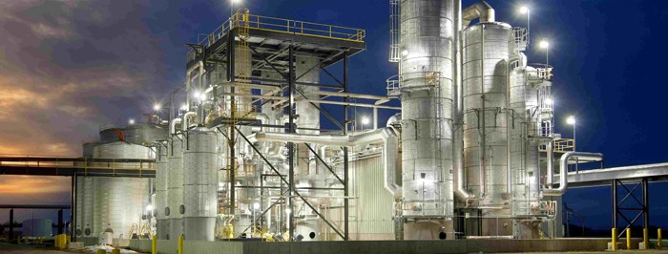
Introduction to Modern Bioreactors
Notes:
http://www.interstates.com/experience/experience-detail/18/Ethanol_Plant

Slide 12
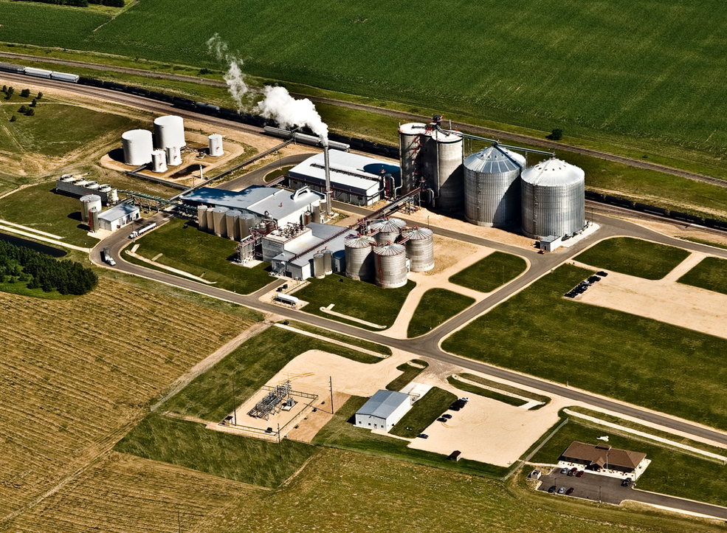
Ethanol plants are complex and it is not obvious what function each component serves
Notes:
http://ethanolproducer.com/articles/7963/western-wisconsin-energy-55-mmgy-ethanol-plant-up-for-grabs

Slide 13
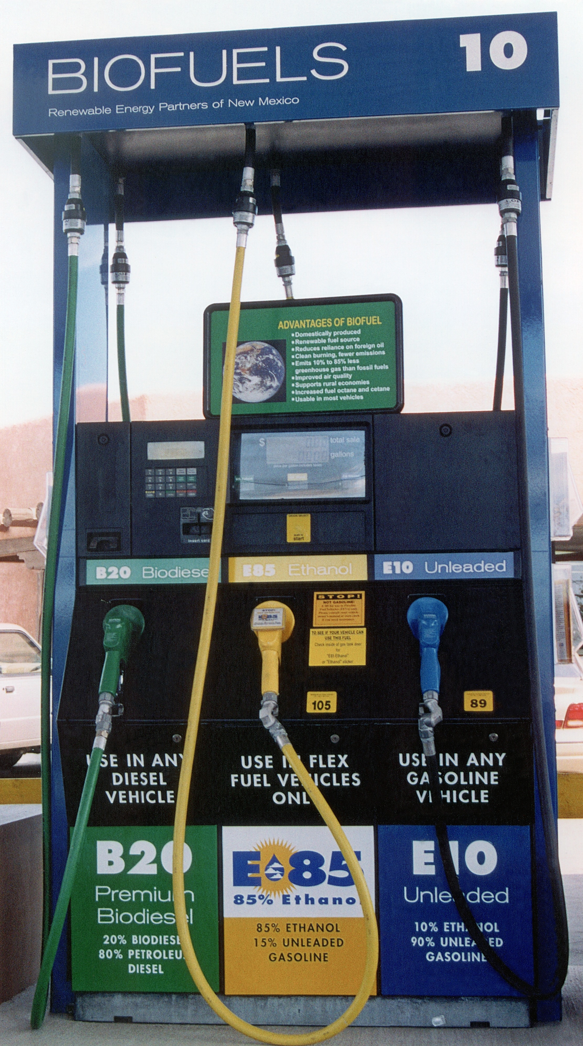
Ethanol as a Biofuel
Ethanol is made from biomass (plant materials) and today is present in upwards of 97% of U.S. gasoline where it helps to reduce air pollution and serves to oxygenate the gasoline
Most of the ethanol produced in the US is made from corn grain and it has a positive energy balance
A positive energy balance is when the sum total of the energy that went into the corn and the fuel production is less than the total energy contained in the fuel

Slide 14
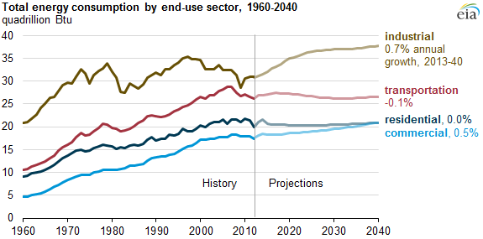
Energy Demand
Source: U.S. Energy Information Administration
Notes:
https://www.eia.gov/todayinenergy/detail.php?id=21012

Slide 15
Ampli Bioreactor
A Summary of the Introductory Level

Slide 16
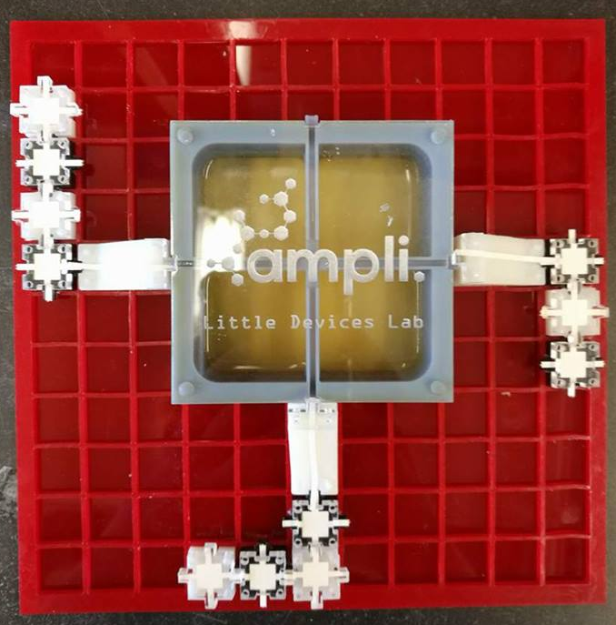
Introductory Level Ampli activities:
Free-form experiment design:
Test flow with food coloring
Raise and lower pH
Create chemical circuits!
Study fermentation:
Examine & quantify ethanol production
Observe by-products of fermentation such as pressure & temperature changes
Compare fermentation to regular yeast growth

Slide 17
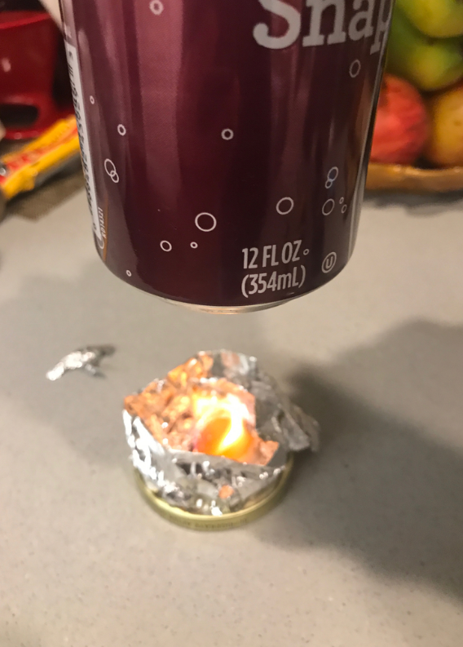
Calorimetry
Measure the heat of a reaction by keeping track of how much it raises the temperature of water
Can be used to study many reactions, and even living organism systems! But is often used to study the heat given off by various substances burning, useful in determining the concept of food calories.
We can use it to demonstrate the utility of ethanol as a fuel (and to note the general purity of our ethanol)!

Slide 18
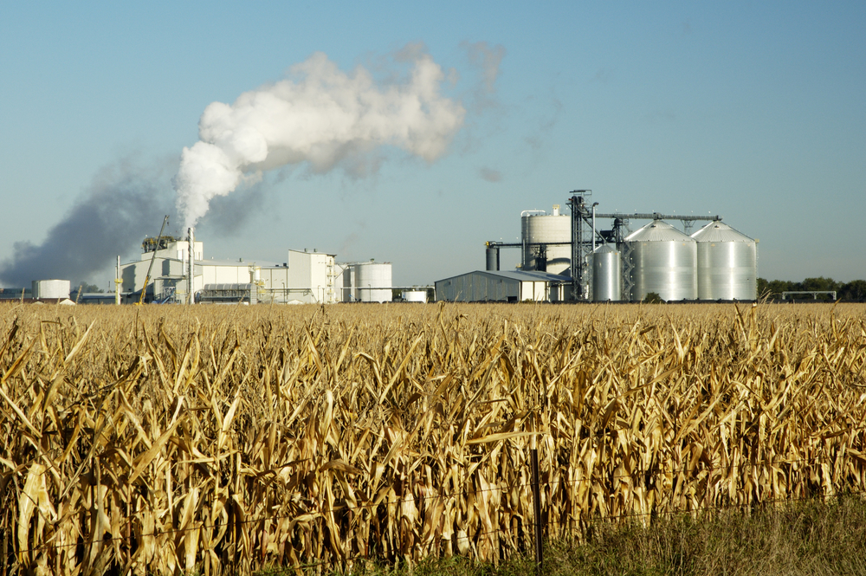
Functions of an Ethanol Plant
Corn storage and milling - grinding corn
Saccharification - heating and cooling a corn mixture
Fermentation
Distillation - purification using boiling
By-product processing - converting by-products into useful forms
Notes:
https://teeic.indianaffairs.gov/er/biomass/restech/desc/ethanolplants/index.htm

Slide 19
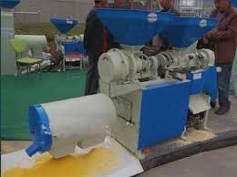
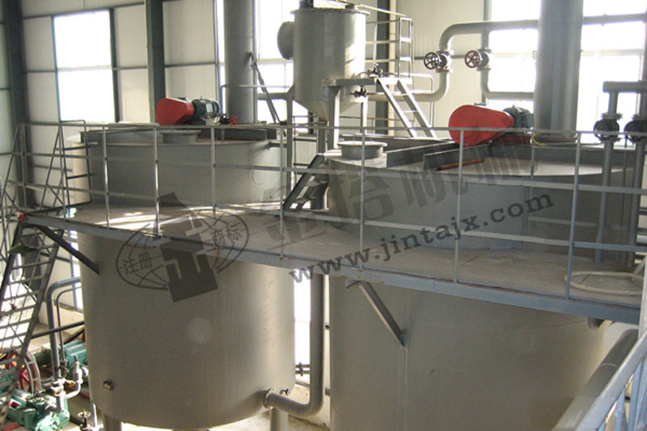
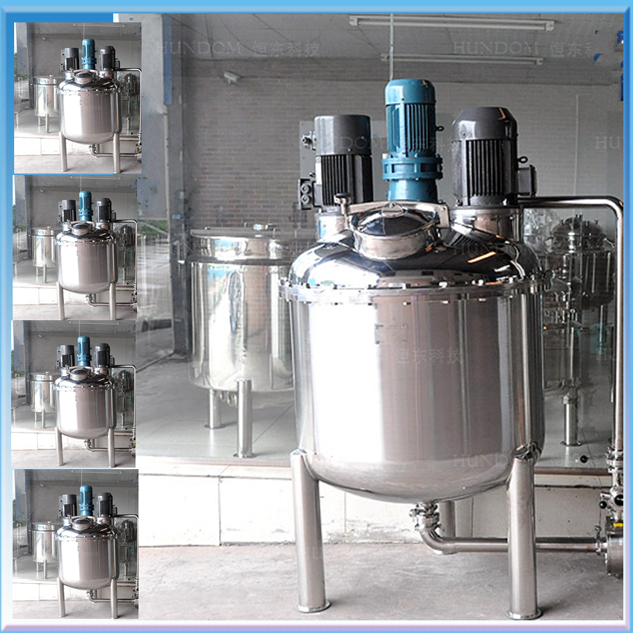
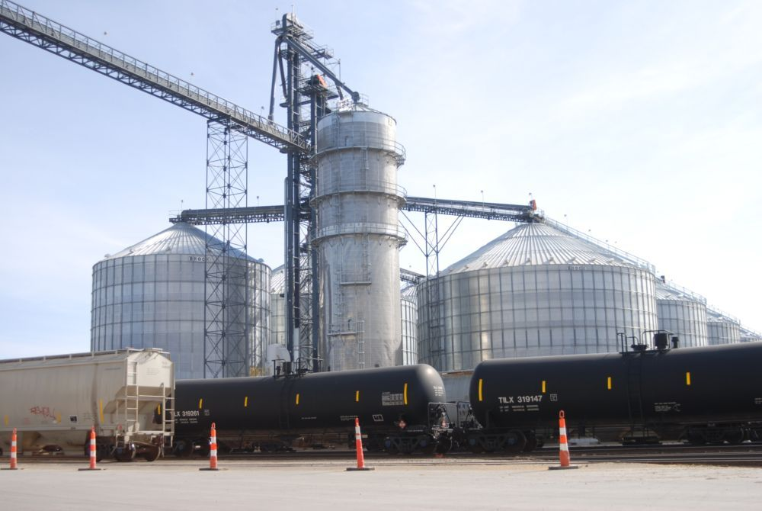
1. Corn storage and milling - the corn is ground down into smaller pieces and stored
2. Saccharification - finely powdered corn is put, along with enzymes, into hot water and then cooled
Corn Milling Machine
Saccharification Chamber
Fermentation Chamber
3. Fermentation - you know all about this step
Corn Storage
4. Distillation - the mixture is purified by heating the ethanol and allowing the ethanol gas to condense into a more pure version of ethanol
5. By-product processing - methods are used to remove many by-products
Notes:
http://en.jintagroup.com/products_detail/productId=80.html
http://megaplantyu.com/product_xxx.asp?id=817
https://sc02.alicdn.com/kf/HTB10RSUKpXXXXaHXFXX760XFXXXh/Hot-sale-Marmita-Machine-Fermentation-Tank.png

Slide 20
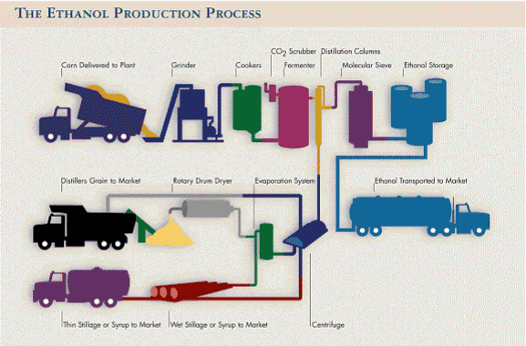
Source: Renewable Fuels Association
0:36 - 2:47
https://www.youtube.com/watch?v=6HrJqQI9joI

Slide 21
Ampli Bioreactor
A Summary of the Advanced Level

Slide 22
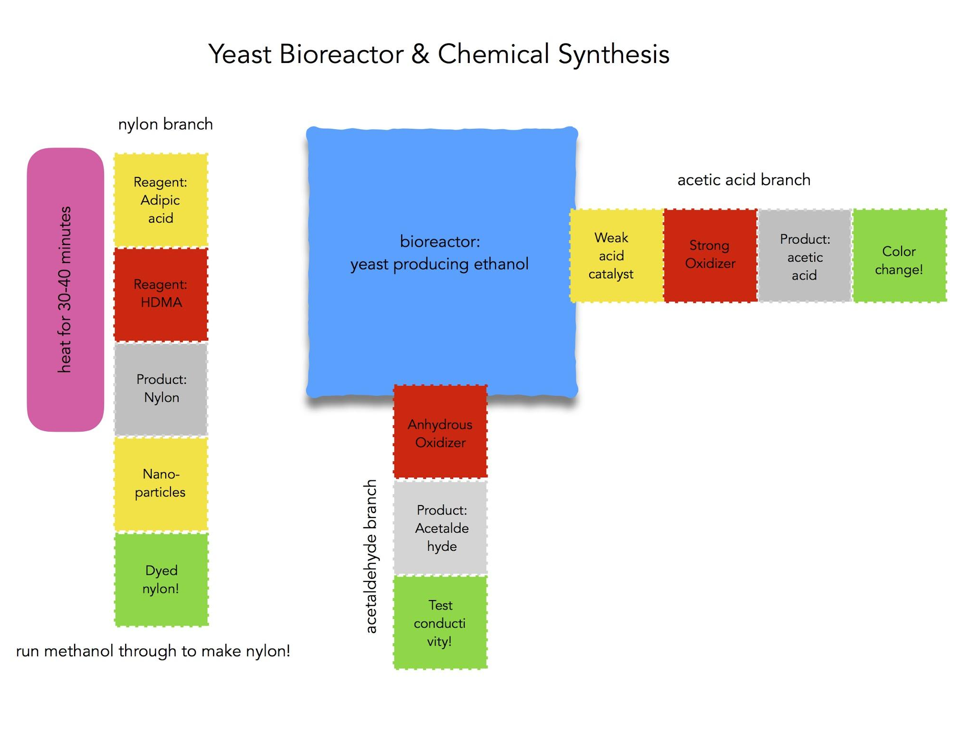
Advanced Level Ampli Activities:
Chemical Reaction Circuit:
Set up a linear chemical reaction
Employ heating and pipetting elements
Discover uses of nanoparticles
Create nylon polymers!
Organic Synthesis using Bioreactor Products:
Evaluate fermentation success
Use bioreactor ethanol in multiple simultaneous chemical reactions
Carry out organic synthesis of ethanol derivatives
Evaluate products with pH, conductivity, and more!

Slide 23
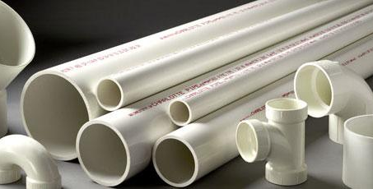
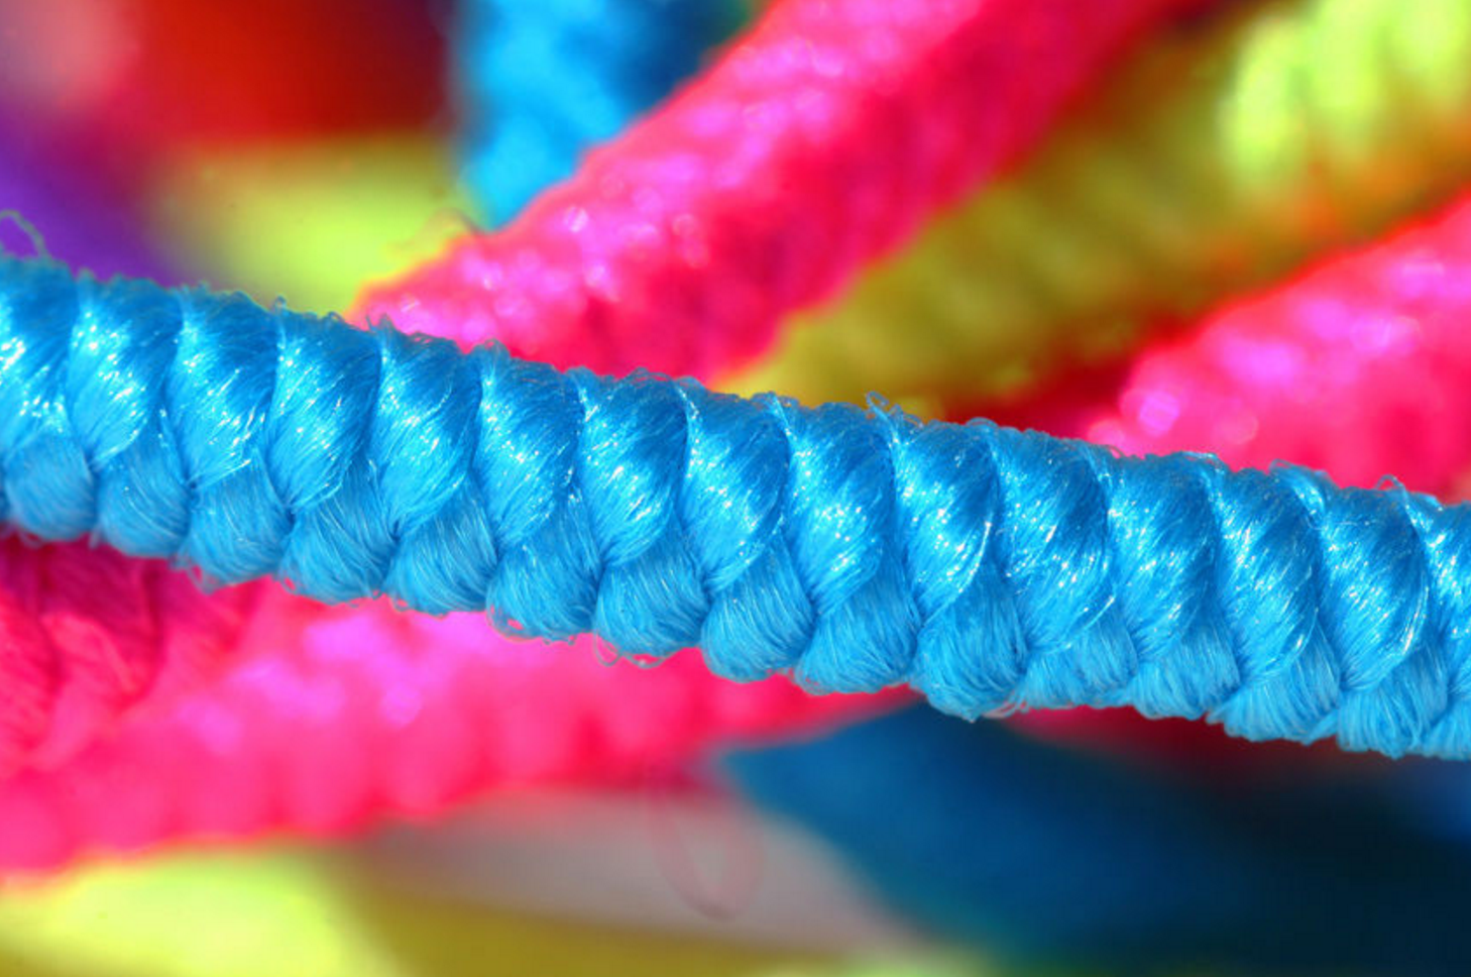
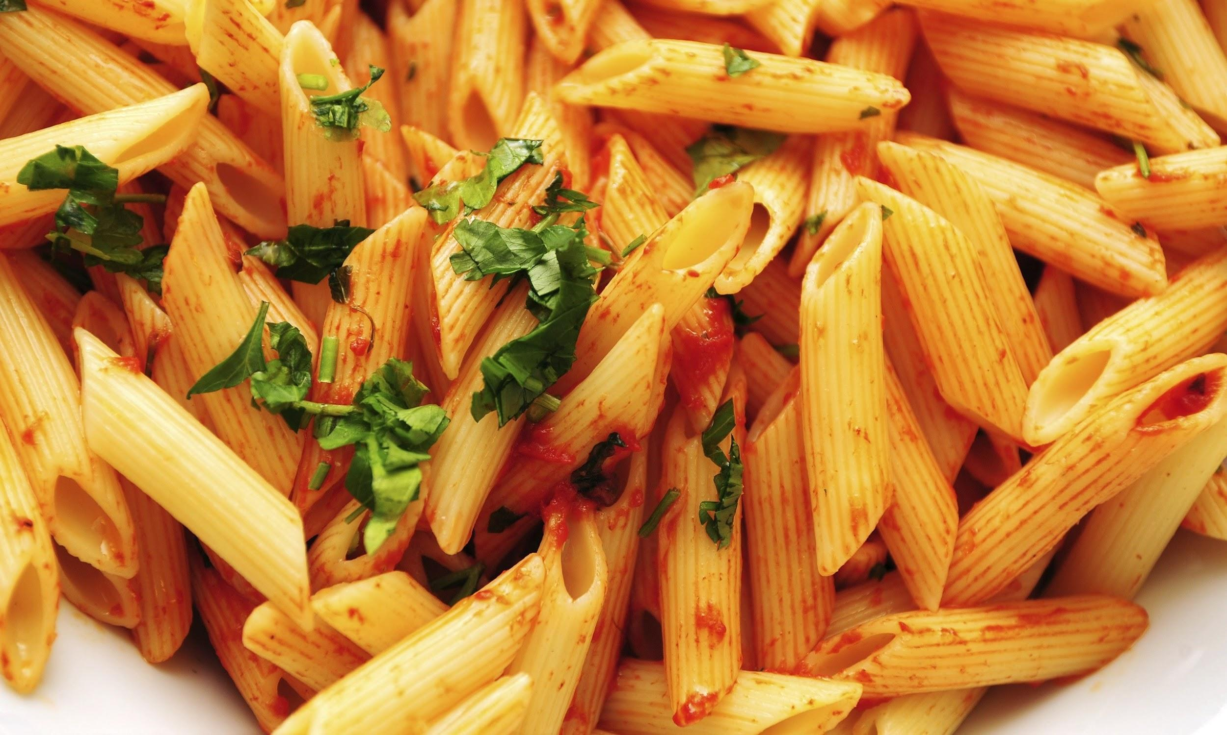
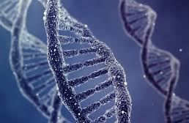
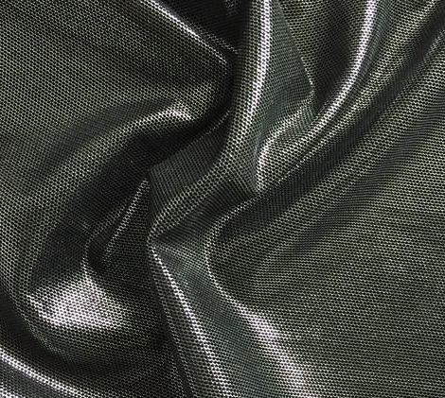
Monomers are small molecules that are able to join with other small molecules (sometimes the same, sometimes different) in a chain to form very long molecules, often with special properties. These are called polymers.
Polymers
Notes:
Polymers

Slide 24
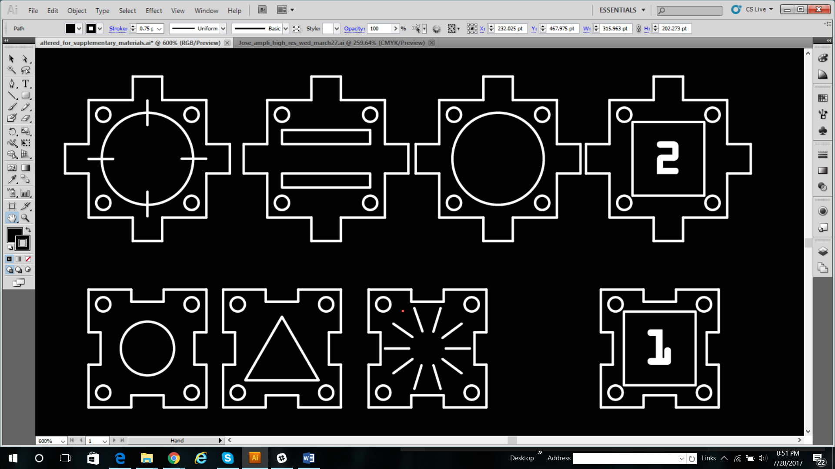
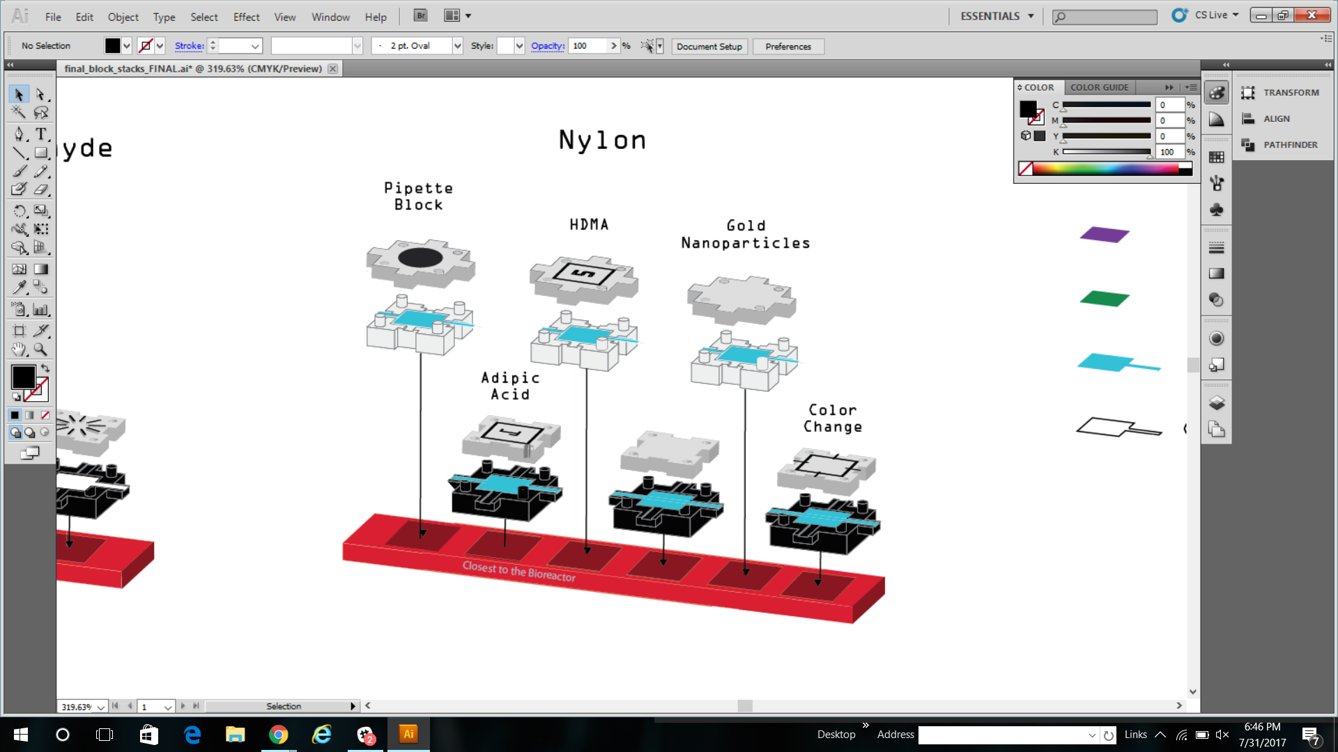
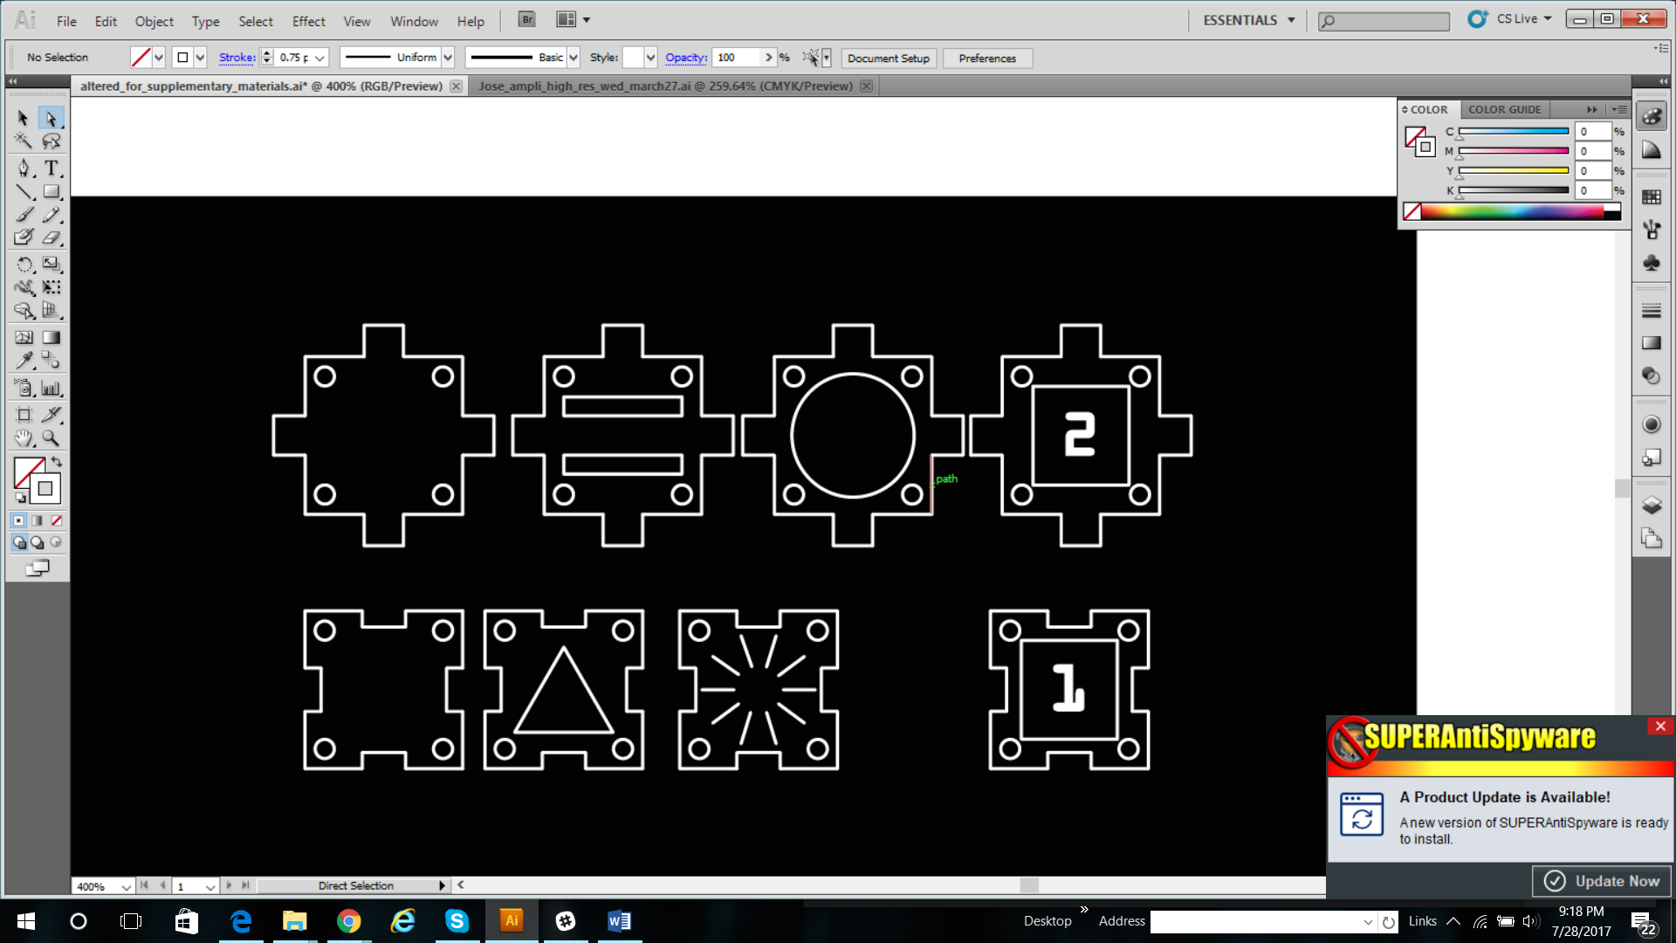
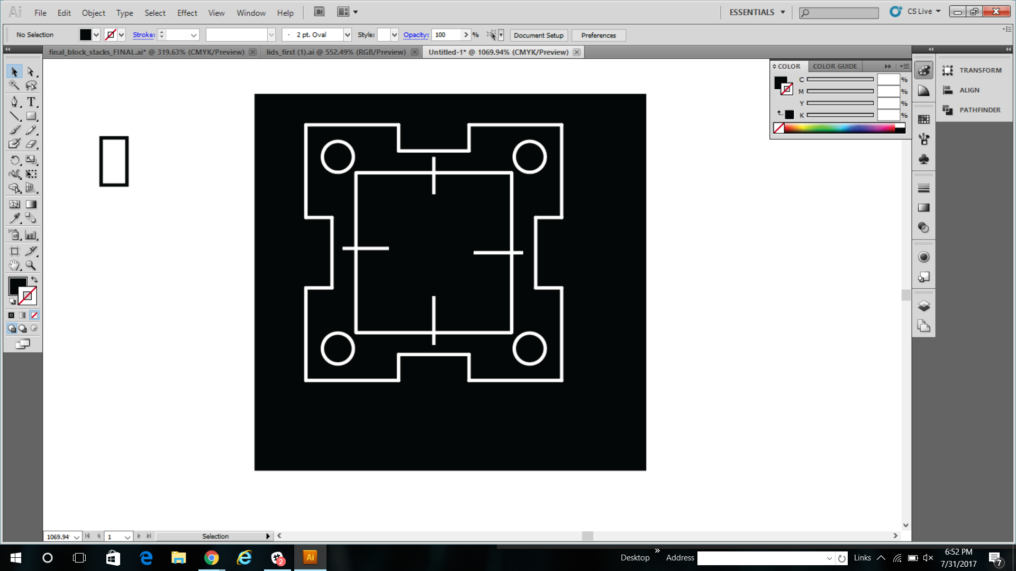
Polymers:
Blank: pipette block (hole
In the lid!!)
Adipic acid
HMDA
Blank
Gold Nanoparticles
Color change

Slide 25
What is Organic Chemistry?
Organic chemistry is….
The study of organic molecules, that is, the carbon-based molecules that make up living organisms (on this planet)
The discipline also involves organic synthesis…
The study of how to build complex organic molecules from starting materials with very few carbons, by substituting various small structural subgroups, called “functional groups”, for one another.
Notes:
Organic chemistry

Slide 26
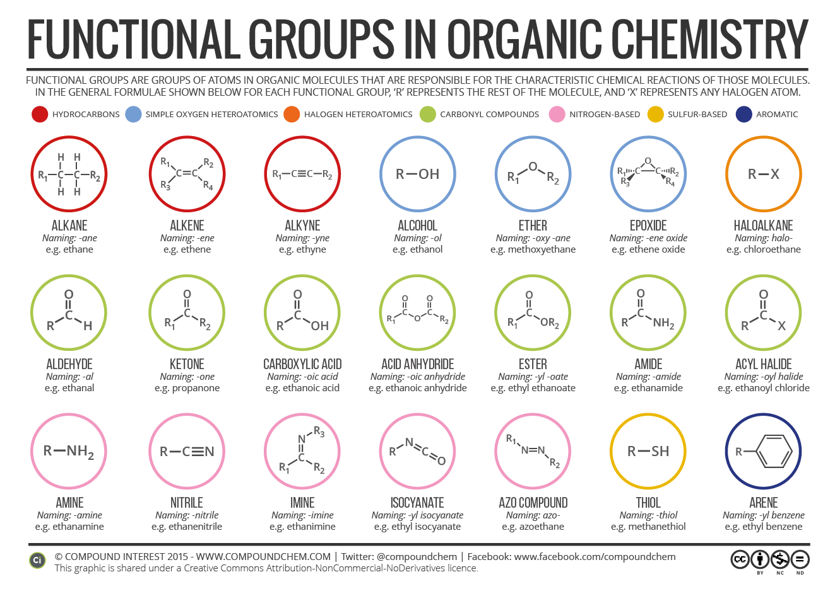
Organic
Chemistry:
For instance, you can add carbon-oxygen bonds to ethanol to make other functional groups: aldehydes and carboxylic acids!

Slide 27
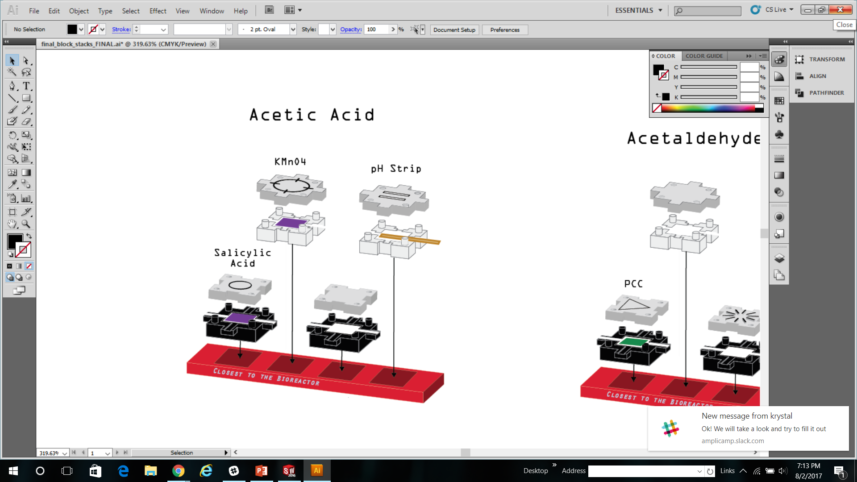
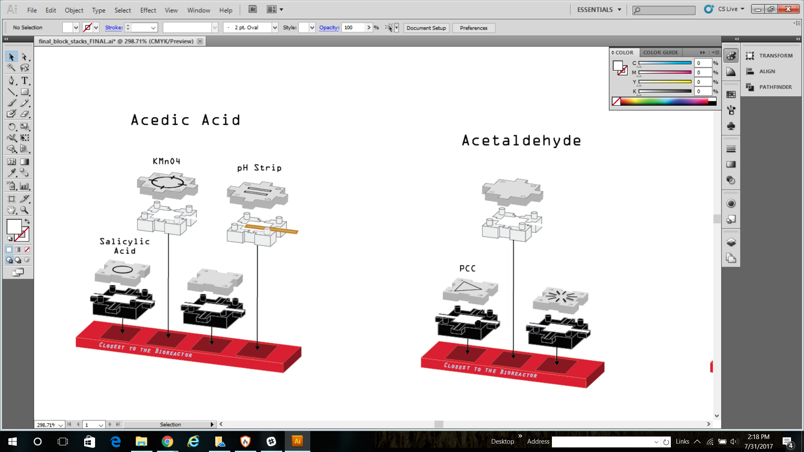
Salicylic Acid
OR dilute strong acid
KMNO4
Blank
Prepare:
pH strip
Organic
Chemistry:
PCC
Blank
Blank
Notes:
Rxn instructions

Slide 28
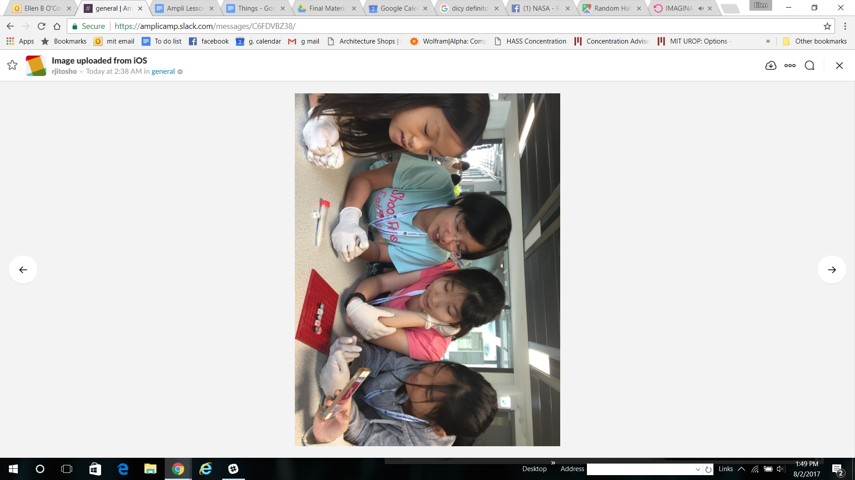
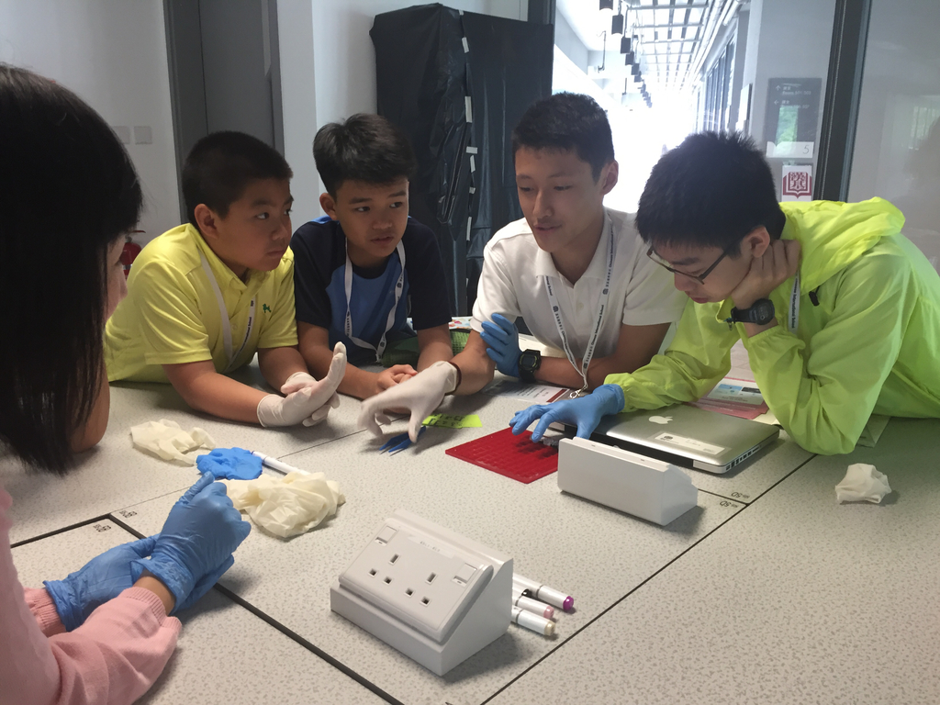
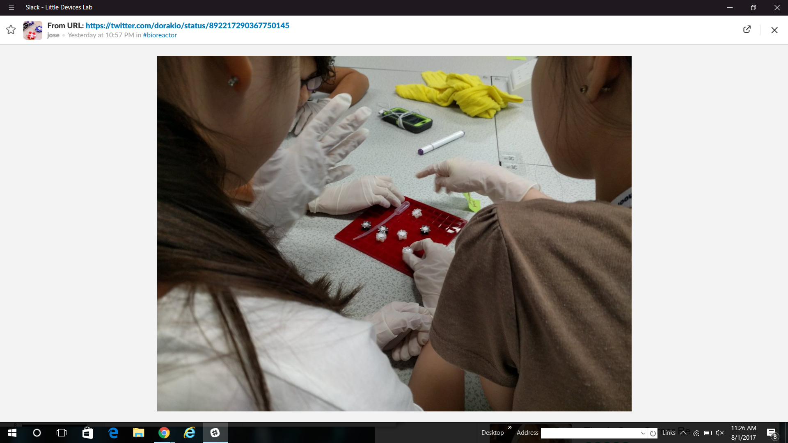
Photos from the week
Credit: Akio lida Twitter @dorakio
Credit: Rianna Jitosho
Credit: Rianna Jitosho
Notes:
https://twitter.com/dorakio/status/892214457274740736
https://twitter.com/dorakio/status/892217290367750145
rianna Jitosho

Slide 29
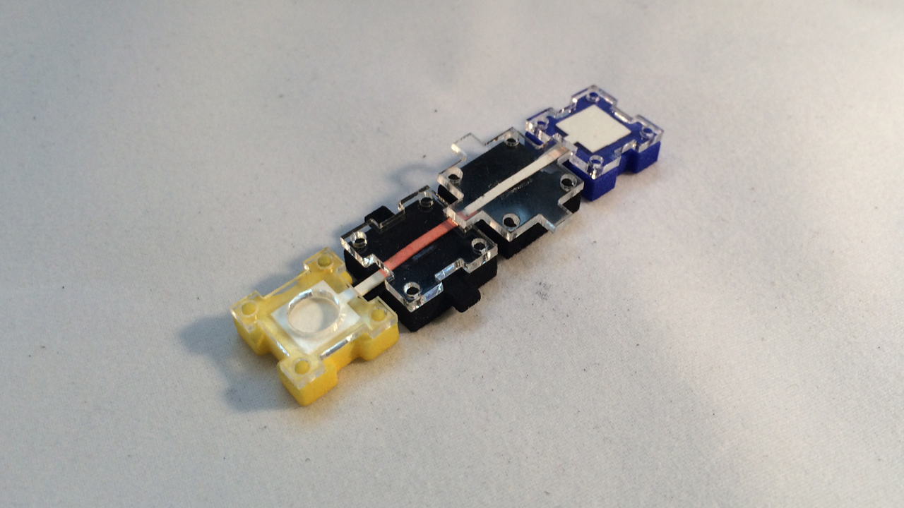

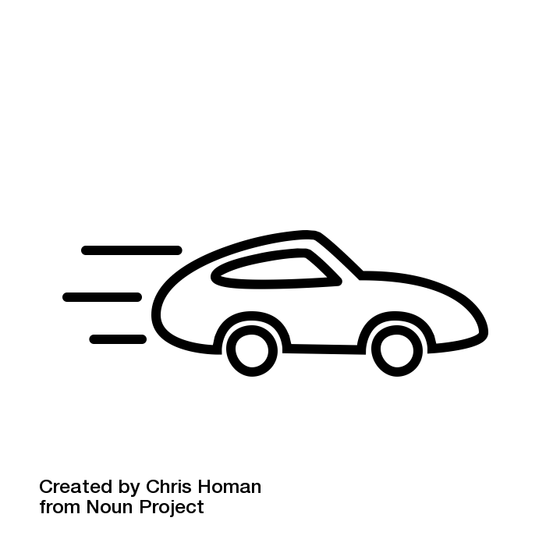
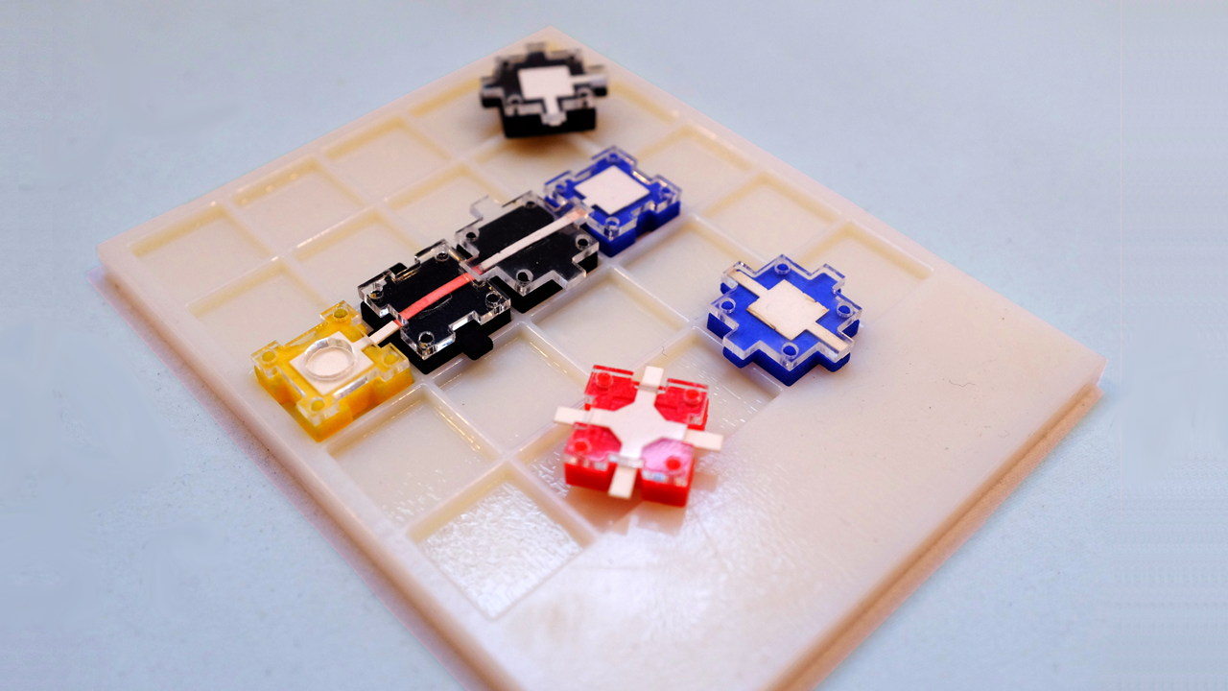
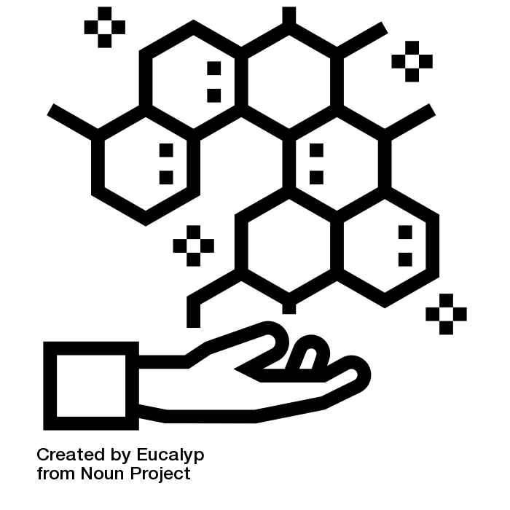
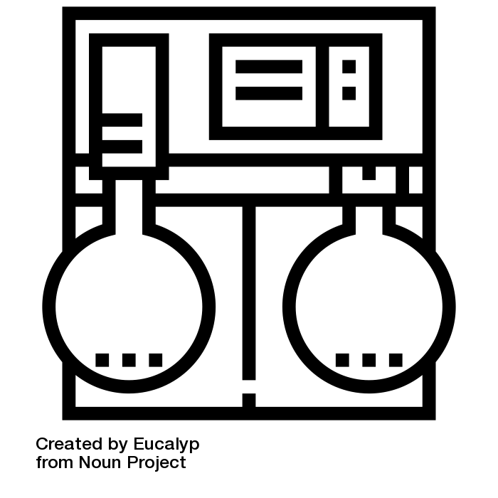
What Makes Ampli Unique?
Safety
Speed
Equipment
Programmable Biochemistry
Notes:
http://makerfaire.com/maker/entry/52132/
Safety - chemicals are easily contained and risk is significantly reduced. This allows students to work with chemicals that they otherwise would not have access to.
Speed - it has been experimentally observed that reactions tend to proceed more quickly on paper than with traditional lab equipment.
Equipment - traditional expensive lab equipment is not necessary.
Freedom/Programmable Biochemistry - kids are able to experiment with directions of flow paths, interactions between paths, length of reaction papers, and many other variables that are not possible with traditional lab equipment. Students are able to stop reactions at certain points which something that is tricky/impossible with traditional methods.
*You can also talk about the modular nature of Ampli and how it lends itself well to programmable biochemistry
Idea by Chris Homan from the Noun Project

Slide 30
Implementing Ampli in the Classroom
You’ve asked us:
How long does it take to prepare a kit for classroom use?
Ampli is designed to be ready-to-react on opening. Blocks will come pre-spotted with chemicals, and can be refilled after use. Projects should require little to no preparation before class.
What kinds of Ampli projects could be experienced in a 30 minute class session or science club meeting? What other kinds of Ampli projects are there?

Slide 31
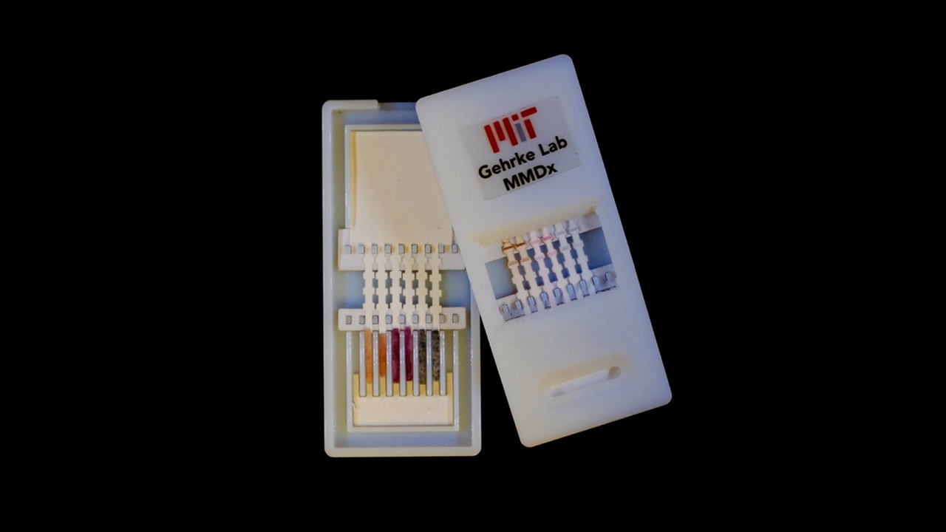

Short Ampli Health Activities
There are lots of activities you could do with Ampli kits that are relevant to health sciences, and could be done in about 30 minutes in the classroom with minimal preparation. Some examples:
Ampli Diagnostics
Create and test Ampli diagnostics for virus antigens, cancer markers, drug adherence, and more using conjugated nanoparticles
Blood-Type Teaching
Educational blood-typing activities to explore antigen compatibility and simulate real-world health and forensic scenarios

Slide 32


Short Ampli Chemistry Activities
“Glow Stick Chemistry”
TCPO gives many glow sticks their characteristic glow. Make your own chemiluminescence on paper!
Oxidation-Reduction with Multiple Color Changes
NaOH and KMnO4 drive this reaction on paper with purple, blue, green, and orange color changes.
TCPO Dye sodium acetate H2O2->GLOW
KMnO4 NaOH/Glu Dose 1 NaOH/Glu Dose 2 Precip.
Each would require a lesson of 30 minutes to an hour, with visible results
Notes:
**To be finished with more-detailed chemistry blocks**

Slide 33
Overnight Ampli Bioreactor Activities
Unlock the full potential of the Ampli bioreactor with activities done over two short class periods, separated by overnight incubation. Use organism culture methods to explore topics with great potential for creativity and many applications.

Slide 34



Overnight Ampli Bioreactor Activity: Antibiotic Efficacy
What makes an effective antibiotic? Write a hypothesis about what kills bacteria. Test it with Ampli, learn about antibiotics, and discuss emergent multidrug resistance

Slide 35

Overnight Ampli Bioreactor Activity: Marine Pollution Risk
Use visible marine microorganisms like bioluminescent plankton as indicators of ocean pollution impact, and discuss marine conservation and green industry

Slide 36

Where can I order Ampli Kits?
You can visit AmpliScience.com for information on how to order Ampli
You can contact littledevices@mit.edu for more information
By downloading the Ampli App you can receive a coupon code
How much does it cost?
Ampli Kits were designed to be affordable
*Ampli Kits go on sale on September 23rd during MakerFaire NYC but the kits will be sold ONLINE*
Notes:
Can get discount before september 23rd
*You can say this outloud with the “How much does it cost?” section*
Prices will be comparable to everyday lego prices

Slide 37


